Slide 1
Cloud Computing

Slide 2
What is Cloud Computing
The term cloud refers to a network or the internet. It is a technology that uses remote servers on the internet to store, manage, and access data online rather than local drives. The data can be anything such as files, images, documents, audio, video, and more.
There are the following operations that we can do using cloud computing:
Developing new applications and services
Storage, back up, and recovery of data
Hosting blogs and websites
Delivery of software on demand
Analysis of data
Streaming videos and audios

Slide 3
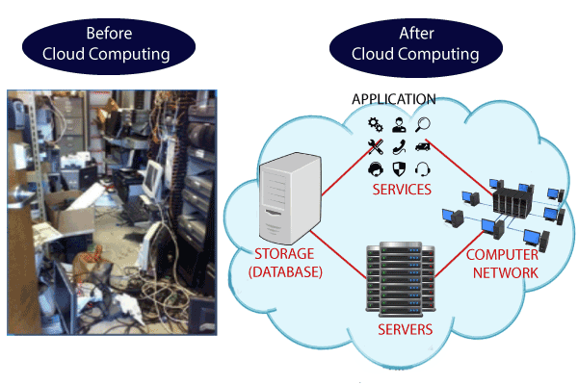
Why Cloud Computing?
Small as well as large IT companies, follow the traditional methods to provide the IT infrastructure. That means for any IT company, we need a Server Room that is the basic need of IT companies.
In that server room, there should be a database server, mail server, networking, firewalls, routers, modem, switches, QPS (Query Per Second means how much queries or load will be handled by the server), configurable system, high net speed, and the maintenance engineers.
To establish such IT infrastructure, we need to spend lots of money. To overcome all these problems and to reduce the IT infrastructure cost, Cloud Computing comes into existence.

Slide 4
Characteristics of Cloud Computing
1) Agility
The cloud works in a distributed computing environment. It shares resources among users and works very fast.
2) High availability and reliability
The availability of servers is high and more reliable because the chances of infrastructure failure are minimum.
3) High Scalability
Cloud offers "on-demand" provisioning of resources on a large scale, without having engineers for peak loads.
4) Multi-Sharing
With the help of cloud computing, multiple users and applications can work more efficiently with cost reductions by sharing common infrastructure.
5) Device and Location Independence
Cloud computing enables the users to access systems using a web browser regardless of their location or what device they use e.g. PC, mobile phone, etc. As infrastructure is off-site (typically provided by a third-party) and accessed via the Internet, users can connect from anywhere.
6) Services in the pay-per-use mode
Application Programming Interfaces (APIs) are provided to the users so that they can access services on the cloud by using these APIs and pay the charges as per the usage of services.

Slide 5
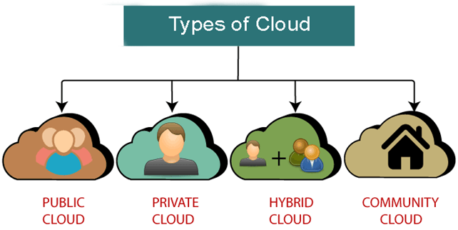
Types of Cloud
Public Cloud
Public cloud is open to all to store and access information via the Internet using the pay-per-usage method.
In public cloud, computing resources are managed and operated by the Cloud Service Provider (CSP).
Example: Amazon elastic compute cloud (EC2), IBM SmartCloud Enterprise, Microsoft, Google App Engine, Windows Azure Services Platform.
Private Cloud
Private cloud is also known as an internal cloud or corporate cloud. It is used by organizations to build and manage their own data centers internally or by the third party. It can be deployed using Opensource tools such as Openstack and Eucalyptus.
Hybrid Cloud
Hybrid Cloud is a combination of the public cloud and the private cloud. we can say:
Hybrid Cloud = Public Cloud + Private Cloud
Hybrid cloud is partially secure because the services which are running on the public cloud can be accessed by anyone, while the services which are running on a private cloud can be accessed only by the organization's users.
Example: Google Application Suite (Gmail, Google Apps, and Google Drive), Office 365 (MS Office on the Web and One Drive), Amazon Web Services.

Slide 6
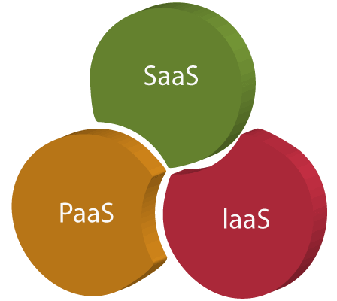
Cloud Service Models
There are the following three types of cloud service models -
Infrastructure as a Service (IaaS)
Platform as a Service (PaaS)
Software as a Service (SaaS)

Slide 7
Infrastructure as a Service (IaaS)
IaaS is also known as Hardware as a Service (HaaS). It is a computing infrastructure managed over the internet. The main advantage of using IaaS is that it helps users to avoid the cost and complexity of purchasing and managing the physical servers.
Characteristics of IaaS
There are the following characteristics of IaaS -
Resources are available as a service
Services are highly scalable
Dynamic and flexible
GUI and API-based access
Automated administrative tasks
Example: DigitalOcean, Linode, Amazon Web Services (AWS), Microsoft Azure, Google Compute Engine (GCE), Rackspace, and Cisco Metacloud.

Slide 8
Platform as a Service (PaaS)
PaaS cloud computing platform is created for the programmer to develop, test, run, and manage the applications.
Characteristics of PaaS
There are the following characteristics of PaaS -
Accessible to various users via the same development application.
Integrates with web services and databases.
Builds on virtualization technology, so resources can easily be scaled up or down as per the organization's need.
Support multiple languages and frameworks.
Provides an ability to "Auto-scale".
Example: AWS Elastic Beanstalk, Windows Azure, Heroku, Force.com, Google App Engine, Apache Stratos, Magento Commerce Cloud, and OpenShift.

Slide 9
Software as a Service (SaaS)
SaaS is also known as "on-demand software". It is a software in which the applications are hosted by a cloud service provider. Users can access these applications with the help of internet connection and web browser.
Characteristics of SaaS
There are the following characteristics of SaaS -
Managed from a central location
Hosted on a remote server
Accessible over the internet
Users are not responsible for hardware and software updates. Updates are applied automatically.
The services are purchased on the pay-as-per-use basis
Example: BigCommerce, Google Apps, Salesforce, Dropbox, ZenDesk, Cisco WebEx, ZenDesk, Slack, and GoToMeeting.

Slide 10
Cloud Service Provider Companies
Amazon Web Services (AWS)
AWS (Amazon Web Services) is a secure cloud service platform provided by Amazon. It offers various services such as database storage, computing power, content delivery, Relational Database, Simple Email, Simple Queue, and other functionality to increase the organization's growth.
2. Microsoft Azure
Microsoft Azure is also known as Windows Azure. It supports various operating systems, databases, programming languages, frameworks that allow IT professionals to easily build, deploy, and manage applications through a worldwide network. It also allows users to create different groups for related utilities.
3. Google Cloud Platform
Google cloud platform is a product of Google. It consists of a set of physical devices, such as computers, hard disk drives, and virtual machines. It also helps organizations to simplify the migration process.
4. IBM Cloud Services
IBM Cloud is an open-source, faster, and more reliable platform. It is built with a suite of advanced data and AI tools. It offers various services such as Infrastructure as a service, Software as a service, and platform as a service. You can access its services like compute power, cloud data & Analytics, cloud use cases, and storage networking using internet connection.

